Slide 1
DATA PRIVACY
USING
K-ANONYMITY, L-DIVERSITY AND
T-CLOSENESS
Submitted by:
Nishit Gupta IIT2014502
Sahil Prakash IIT2014504
Sacheendra Mohan Singh IIT2014506
Project Supervisor
Dr. K.P. Singh

Slide 2
MOTIVATION
Various organizations often need to publish micro data (e.g. medical data, census data, employee data) for research, study and other purposes.
This field-structured and person specific data is prone to attacks and misuse.
The identity reveal can be a threat to a person’s job, family and most importantly life.
The data holders need to share a version of the data to the requesting authority.
So, there is a requirement that the data must be released in a version which has the scientific guarantee that the individuals who are a subject of the data can not be re-identified while the data remain practically useful.

Slide 3
OBJECTIVE
To implement various data privacy techniques such as
K-anonymity
L-diversity
T-closeness.
Analyze the flaws and advantages of each mentioned technique.
Finding out whether Machine Learning (training the system) methods could be incorporated for identity disclosure.
Applying various Machine Learning algorithms for feature extraction and verifying the same.

Slide 4
LITERATURE SURVEY
S No. | Author | Paper Title | Year | Crux | Venue
1. | Latanya Sweeney | K-Anonymity: A Model for protecting privacy.^{[1]} | 2002 | This Paper introduces a formal protection model called k-anonymity and a set of accompanying policies for deployment . A released table provides k-anonymity protection if information for each person contained cannot be distinguished from at least k-1 individuals whose information is also in the dataset. | International Journal of Uncertainty, Fuzziness and Knowledge-Based Systems October 5,2002
2. | A.Machanavajjhala J. Gehrke D.Kifer M.Venkitasubramaniam | l-Diversity: Privacy Beyond K- Anonymity.^{[2]} | 2006 | In this paper it is shown that k-anonymity model does not guarantee privacy against attackers using two simple attacks, first, lack of diversity in sensitive attributes, second, using background knowledge . It proposes a powerful privacy definition called l - diversity which requires that each equivalent class has at least l well represented values for sensitive attribute. | Data Engineering, 2006. ICDE ‘06. Proceedings of the 22nd International Conference on 3-7 April 2006
3. | Ninghui Li Tiancheng Li Suresh Venkatasubramanian | T-closeness: Privacy Beyond K-Anonymity and l-Diversity.^{[3]} | 2007 | This Paper shows limitations of l-diversity and then proposes another privacy notion called t-closeness , which requires that the distribution of sensitive attribute in any equivalence class is close to the distribution of the attribute in overall table. EMD is proposed as a distance measure, to evaluate the closeness. | Data Engineering, 2007. ICDE 2007. IEEE 23rd International Conference on 15-20 April 2007

Slide 5
TARGETS ACHIEVED TILL NOW
Implemented all the three data privacy techniques – K-anonymity, L-diversity and T-closeness.
Step by Step analyzed the advantages and flaws of each technique and realized the need of one technique over the other.
Verified whether identity could be revealed with the anonymized data by
Running the same Query on Original Data and Anonymized Data.
Doing a Survey of the output obtained from both the queries.

Slide 6
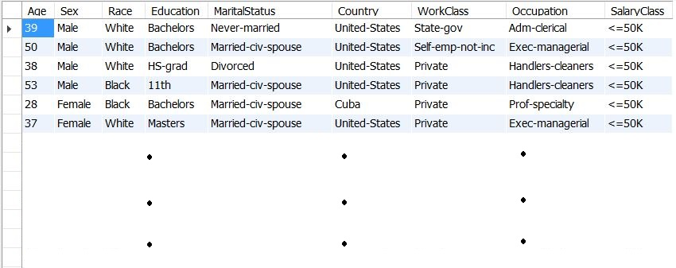
DATA-SET^{[4]}

Slide 7
METHODOLOGICAL STEPS
K-Anonymity
Let T(A₁,A₂,.........,A_{n}) be a table and QI_{T} be the quasi-identifier associated with it. T is said to satisfy k-anonymity if and only if each sequence of values in T[QI_{T}] appears with at least k-occurrences in T[QI_{T}].

Slide 8
To implement k-anonymity, the following generalizations are applied:
Age :
1 -> 1-30
2 -> 31-60
3 -> 61-120
Gender (Suppressed) :
Any -> {Male. Female}
Race (Suppressed) :
Any -> {Black, White}
Education :
School -> {1st-4th, 5th-6th,7th-8th,9th, 10th, 11th, 12th}
Undergraduate -> {Some-college, Bachelors}
Graduate -> {HS-grad, Assoc-voc, Assoc-acdm, Prof-school, Doctorate, Masters}
Marital Status :
spouse present -> {Married-civ-spouse, Married-AF-spouse}
spouse not present -> {Divorced, Never-married, Separated, Widowed, Married-spouse-absent}
Work Class :
Government -> {Federal-gov, Local-gov, State-gov}
Non-Government -> {Private, Priv-house-serv, Self-emp-not-inc, Self-emp-inc}
Unemployed -> {Without-pay, Never-worked}
Country :
A*a -> [Asia, America, Africa] ={United-States, Cambodia, Puerto-Rico, Canada, Outlying-US(Guam-USVI-etc), India, Japan, South China, … }
Europe -> {Holand-Netherlands, England, Germany, Greece, Italy, Poland, Portugal, Ireland, France, … }

Slide 9

K-Anonymity Result
Queried Data
For the record shown above, after applying the k-anonymity approach on the data-set, we got the following equivalent class as the result :
It can be seen from above result, that we are still able to identify the Occupation of the record as ‘Craft-repair’, as all the records in the equivalent contain the same value, leading to Attribute-disclosure.
To improve upon this, the approach of l-diversity is used.

Slide 10
L-Diversity
An equivalence class is l-diverse if it contains at least ‘l’ well represented values for sensitive attribute S. A table is l-diverse if every equivalence class is l-diverse.
Distinct l- Diversity
An equivalence class has distinct l-diversity if it has at least ‘l’ well - defined sensitive values. When each equivalence class in the table has distinct l-diversity, the table is said to be having distinct l-diversity.

Slide 11
To implement l-diversity :
The Occupations were divided into 3 groups so that each group had almost equal frequencies in the original data set and the l-diversity principle was then applied on each group :
Group 1 = {Tech-support, Craft-repair, Prof-specialty, Machine-op-inspct}
Group 2 = {Sales, Exec-managerial, Handlers-cleaners}
Group 3 = {Other-service, Adm-clerical, Farming-fishing, Transport-moving, Priv-house-serv,… }
Generalizations (with addition/changes to K-anonymity)
Work Class :
Employed -> {Federal-gov, Local-gov, State-gov, Private, Priv-house-serv, … }
Unemployed -> {Without-pay, Never-worked}
Education :
School -> {1st-4th, 5th-6th,7th-8th,9th, 10th, 11th, 12th}
Graduate -> {Some-college, Bachelors, HS-grad, Prof-school, Doctorate, Masters}
For some records, the following generalizations were applied on Age :
4 -> {31-120}
5 -> {1-30} OR {61-120}

Slide 12
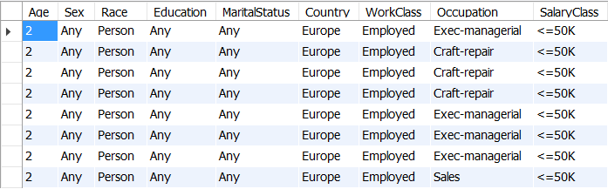
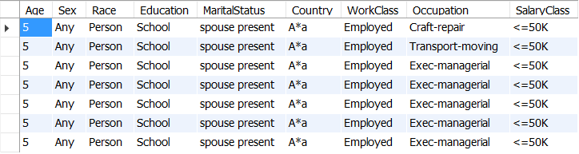
After implementing L-diversity, we get the above output for the query which improves the flaw of K-anonymity.
But for the following equivalence class
We have 5 records out of 7 which have Occupation as ‘Exec-managerial’ (71.4 %). In the original dataset, there were 663 out of 5000 records with Occupation as Exec-managerial (13.26 %).
This leads to skewness attack, where we can infer more details about a particular class as compared to the original dataset.
The quality of data is also reduced.
L-Diversity Result

Slide 13
T-Closeness
An equivalence class has t-closeness, if the distance between distribution of sensitive attribute in that class and the distribution of that attribute in the overall table is not more than a threshold ‘t’.
Metric for calculating the distance: Earth Mover Distance (EMD)
EMD : minimal amount of work needed to transform one distribution to another. Let one distribution be assumed as mass of earth lying in space. The second distribution is assumed as holes in space. We need to fill masses in holes. This is EMD.
EMD between distributions P = (p₁,p₂,p₃,...) and Q = (q₁,q₂,q₃,...)
f_{i,j} = flow of mass from element i of P to element j of Q
d_{i,j} = ground distance between element i of P and element j of Q
EMD : D[P,Q] = ∑ ∑ d_{i,j} f_{i,j}

Slide 14
To implement t-closeness :
All generalizations for K-anonymity were used. However some changes were done which are as follows:
Education :
School -> {1st-4th, 5th-6th, 7th-8th, 9th, 10th, 11th, 12th}
Undergraduate -> {Some-college, Bachelors}
Graduate -> {HS-grad, Assoc-voc, Assoc-acdm, Prof-school, Doctorate, Masters}
For some records, the following generalizations were applied on the Education attribute :
School/Grad -> {1st-4th, 5th-6th, 7th-8th, 9th, Prof-school, Doctorate, Masters}
School/UG -> {1st-4th, 5th-6th, 7th-8th, 9th, Some-college, Bachelors}
For some records, the following generalizations were applied on the Age:
4 -> {1-60}
5 -> {1-120}
For some records, the following generalizations were applied on the Salary:
Any -> <=50K or >50K

Slide 15
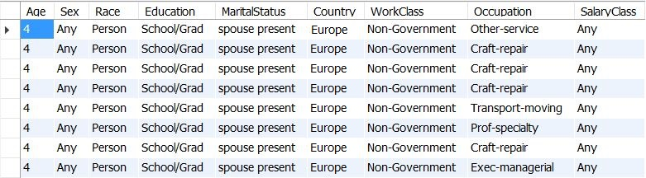
T-Closeness Result
After implementing t-closeness approach, we get the following class for the same record :
We observe that we overcome the limitations of both the k-anonymity approach (attribute disclosure) as well as l-diversity approach (skewness attack).
The advantages of data security comes at the price of reduced quality of the released data-set.
To better incorporate the results of the approaches, it is beneficial to implement k-anonymity and t-closeness together.

Slide 16
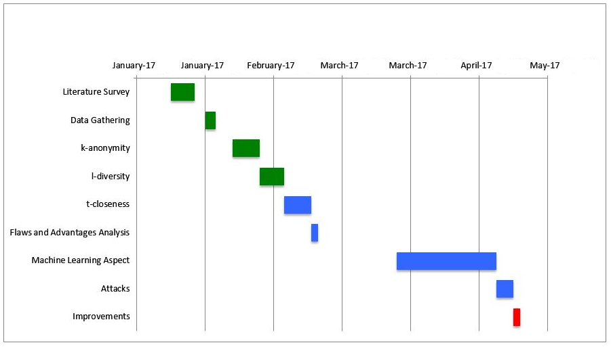
WORK TO BE DONE
Activity Time-Chart
Machine Learning Algorithms to be implemented for feature extraction.
Sampling, Clustering
By picking some arbitrary records as training tuples from different equivalence classes
or
By picking some clusters of data tuples as training set

Slide 17
REFERENCES
[1]. L. Sweeney, “K-Anonymity: A model for protecting privacy”, in International Journal on Uncertainty, Fuzziness and Knowledge-based Systems, 10 (5), 2002
[2]. Ashwin Machanavajjhala, Johannes Gehrke, Daniel Kifer and Muthuramakrishnan Venkitasubramaniam, “L-Diversity : Privacy beyond K-Anonymity”, in Data Engineering, 2006. ICDE '06. Proceedings of the 22nd International Conference on 3-7 April 2006
[3]. Ninghui Li, Tiancheng Li, Suresh Venkatasubramanian, “T-Closeness: Privacy Beyond k-Anonymity and l-Diversity”, in Data Engineering, 2007. ICDE 2007. IEEE 23rd International Conference on 15-20 April 2007
[4]. https://archive.ics.uci.edu/ml/datasets/Adult

Slide 18
Thank You!

